Slide 1
Heart Failures & Survival Rates
Kamaniya Chatakondu
Alberic De Anzi
Santanu Mukherjee

Slide 2
Contents
History
Objective
Scope
Data Source
Exploratory Data Analysis
Research Questions / Possible Solutions
Data Modelling
Insights
Conclusion

Slide 3
History
Heart disease is the leading cause of death for men, women in the United States.
On average, 1 person dies every 36 seconds in the United States from cardiovascular disease.
About 659,000 people in the United States die from heart disease each year—that's 1 in every 4 deaths.
The mean age at onset of heart failure declined slightly from 75 to 74 years over time.
The proportion of patients diagnosed at ≤50 years of age increased from 3% to 6%.
Per CDC, in 2018, heart failure was mentioned on 379,800 death certificates (13.4%).
Per CDC data, Heart failure costs the nation an estimated $30.7 billion in 2012. This total includes the cost of health care services, medicines to treat heart failure, and missed days of work.

Slide 4
High Level Objective and Scope
Objective
Identification of real-life dataset (available in the public domain)
Exploration of the dataset to get initial idea of the data
Analysis of data using statistical tools(regression & classification)
Insights and Recommendation based on analysis
Scope
Extract data from identified data set (Heart Failure Data Set )
Perform EDA (Exploratory Data Analysis) on the dataset
Build multiple models to compare the best fit
Predict based on model fitment
Interpret the results and derive conclusion

Slide 5
Data Source
Data Source
Used UCI Machine Learning Repository (https://archive.ics.uci.edu/ml/index.php) to identify and extract the data set from https://archive.ics.uci.edu/ml/datasets/Heart+failure+clinical+records
The current version of the dataset was elaborated by Davide Chicco (Krembil Research Institute, Toronto, Canada) and donated to the University of California Irvine Machine Learning Repository under the same Attribution 4.0 International (CC BY 4.0) copyright in January 2020.

Slide 6
Data Details
Data Details
This dataset contains the medical records of 299 patients who had heart failure, collected during their follow-up period, where each patient profile has 13 clinical features.
Details of attributes / covariates

Slide 7
Snapshot of Data
Snapshot of Data

Slide 8
Exploratory Data Analysis (EDA)
Exploratory Data Analysis (EDA)
Initial Data Exploration
Review each / combination of variable(s) to better understand the data
Plot different graphs / combinations to have a holistic view of data
Identify which variables are important and impactful
Decide on the research question
Identify the predictors and response variable

Slide 9
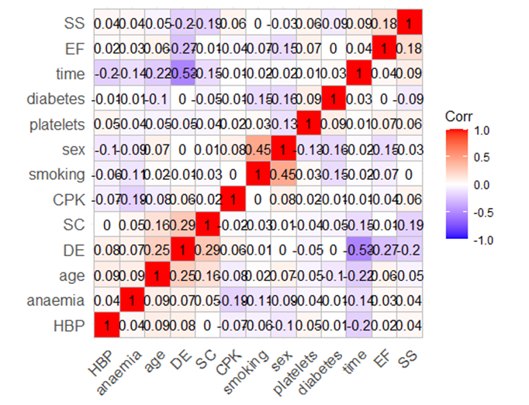
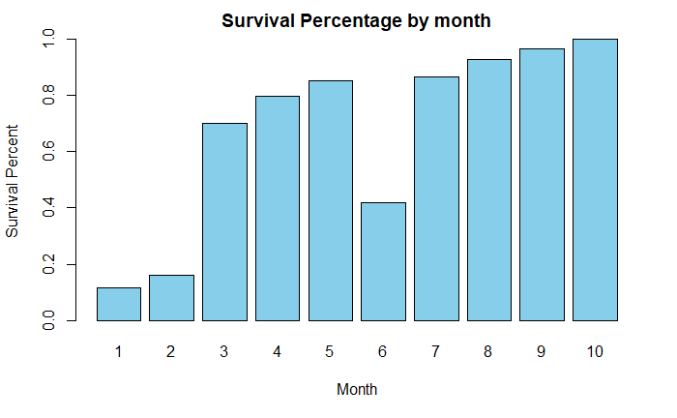
EDA (Visualizations)
Correlation Matrix
DE – Death Event
SC – Serum Creatinine
EF – Ejection Fraction
CPK – Creatinine Phosphokinase
HBP – High Blood Pressure
Survival Matrix

Slide 10
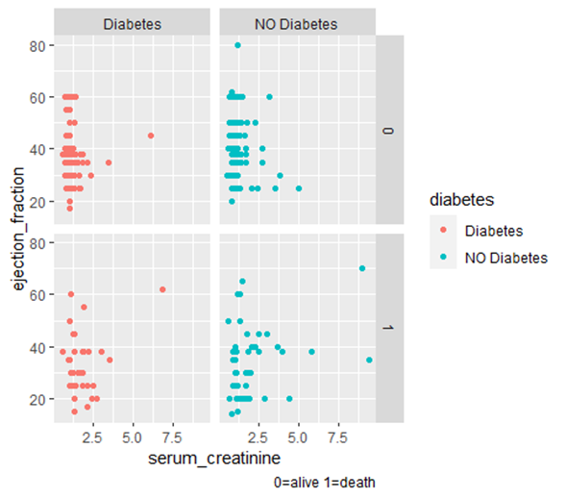
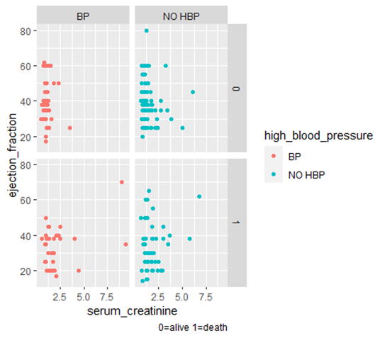
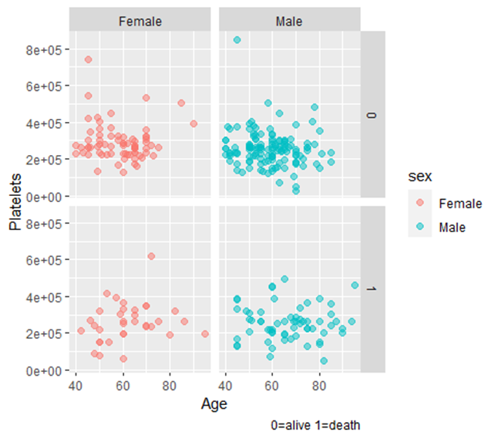
EDA (Visualizations – contd.)

Slide 11
Research Questions
In building the model, is at least one or more of the predictors X1, X2, . . . ,Xp significant ?
Do we need help from all the predictors to explain the response variable Y , or is only a subset of the predictors enough?
Does the model fit well with the data?
How accurate is the prediction given a set of predictor values ?

Slide 12
Logistic Regression
Logistic Regression Results with all predictors – AIC 193.94. The response variable is DEATH_EVENT.
Significant predictors – Ejection Fraction, Serum Creatinine, Time, Age

Slide 13
Logistic Regression – (contd).
Prediction Accuracy in Logistic Regression Results with all predictors = 80.1% , Error = 19.9%

Slide 14
Logistic Regression - stepAIC
Logistic Regression model and Results with optimized parameters as shown by the stepAIC results – AIC 186.9
Significant predictors – Ejection Fraction, Serum Creatinine, Time still the same , but the model has fewer predictors

Slide 15
Logistic Regression – stepAIC (contd)
Prediction Accuracy in Logistic Regression Results where stepAIC has chosen the optimal predictors = 86.5% , Error = 13.5%

Slide 16
Logistic Regression – Multicollinearity
StepAIC will provide a model which removes multicollinearity.
However, the VIF function on the original model (with all parameters) still shows that the values are less than 2.5 , which means there is no “Multicollinearity” in the entire dataset.

Slide 17
Logistic Regression – ROC and AUC
ROC curve showing that to attain the optimal True Positive Rate and False Positive rate is when the probability of success is > 0.5 – this is the point where the prediction accuracy is highest .
The AUC (area under the curve) calculated is 0.80 in that scenario.

Slide 18
LDA
Prediction Accuracy in LDA = 76.9% , Error = 23.1%

Slide 19
QDA
Prediction Accuracy in QDA = 78.8% , Error = 21.2%

Slide 20
KNN (k=16)
Typically, (k=16) is chosen as the square root of number of rows of the training data set.
Prediction Accuracy in KNN = 96% , Error = 4%

Slide 21
Comparison of models
Table comparing the various models listing the Prediction Accuracy and Error Rate
Model | Prediction Accuracy | Error Rate
Logistic Regression | 80.1% | 19.9%
Optimized Logistic Regression(stepAIC) | 86.5% | 13.5%
LDA | 76.9% | 23.1%
QDA | 78.8% | 21.2%
KNN (k=16) | 96% | 4%

Slide 22
Results
Yes, the logistic regression model shows us that there are 4 predictors (viz. ejection fraction, serum creatinine, time, age) that are significant at alpha =0.05.
The results of the stepAIC shows that a subset of all the predictors can explain the response variable (Death Event) adequately.
The model does fit well with the data as the accuracy of the prediction based on the Logistic regression model is 86.5%.
The team ran other classification models like LDA , QDA and KNN.
The KNN model with k=16 gave a prediction accuracy of 96%.
There is no multicollinearity amongst the predictors.

Slide 23
Insights
Based on the logistic model , we see that Diabetes, Smoking, High Blood Pressure, Anemia, Platelets are not significant for the Death_Event.
Although “Age” is a significant variable based on the model, it cannot be controlled or tuned.
The best model shows there is no multicollinearity, but the fact is that all these data represents patients that had heart failures suggests that there is relationship between the predictors.
Platelets are not labelled as significant, but ejection fraction is labelled as significant for the response variable “Death_Event”.
The dataset size is only 299 and with only 13 predictors. A larger dataset would help for more reliable results.
Additional predictors like height, weight, BMI and occupation would greatly help in mitigating risk factors related to patients with heart diseases.

Slide 24
Conclusion
KNN (k=16) may be the model of choice as it has the highest prediction accuracy (96%).
Need to run other KNN models with different K values to validate that this is the best model considering the consequences of overfitting and underfitting.
Logistic Regression model is a close second in terms of prediction accuracy (86.5%). We need to run the model with more data that includes more predictors.
More data (> 299 records) and analysis is recommended before we justify the accuracy of the predictions with the Logistic Model or KNN. Need to gather larger datasets and additional predictors to have better predictions.
Optimal variable Selection with more attributes can lead us to different model selection as well.

Slide 25
Q & A

